Slide 1

Intro to GitHub for Collaboration
Maddie Betts

Slide 2
What is GitHub & what makes it unique?
GitHub is like the Google Drive of software development and code
Version control through Git makes it unique
It’s a “tracked changes” for code
GitHub is super useful for collaboration because it allows multiple users to access code (“pull”), edit it, and then re-share (“push”), and the previous copies of that code are automatically stored
GitHub can be used to store data/codes associated with open-access manuscripts and projects
A lot of pipelines have GitHub repos associated with them – two I’ve used are GTseq and DeepLabCut – where you can find tons of info about how to use

Slide 3

Important Terms of GitHub
BIG terms:
Repository/Repo – where your data are stored; the folder on your desktop
Push – send data to repo
Pull – pull data (and changes from others) to local drive
Ways to interact with repos:
Clone – most common, creates a copy of the repo locally
Branch – rare for our work, think of it as creating a new file to work instead of everyone working in the same google doc
Fork – even rarer, essential a clone that cannot be pushed to OG repo

Slide 4
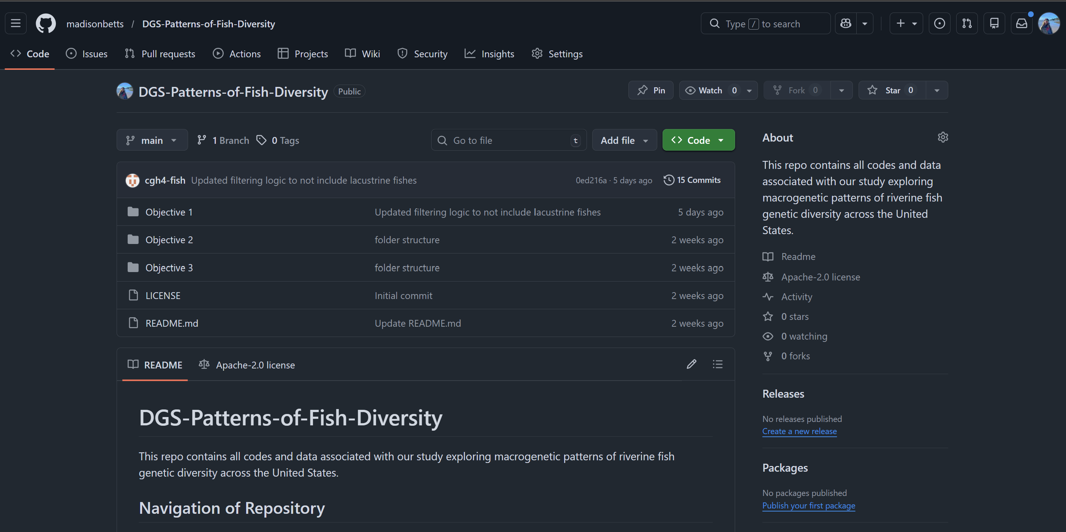
Anatomy of GitHub.com
Settings for repo
Current repo
Current branch
These folders are where all the data, codes, etc get pushed to
When setting up a repo, you have the option to set up a license, which set the “rules” for how others can interact with your repo
Missing currently: .gitignore file!
README is the front page of a repo, and outlines what is contained by the repo
Once analyses are complete, you can publish a “release” which will freeze the repo for reproducibility

Slide 5
Using GitHub Desktop
GitHub Desktop is a GUI that simplifies pushing/pulling
Use it to clone repositories, make commits, create branches, and sync changes with GitHub without needing to use the command line

Slide 6
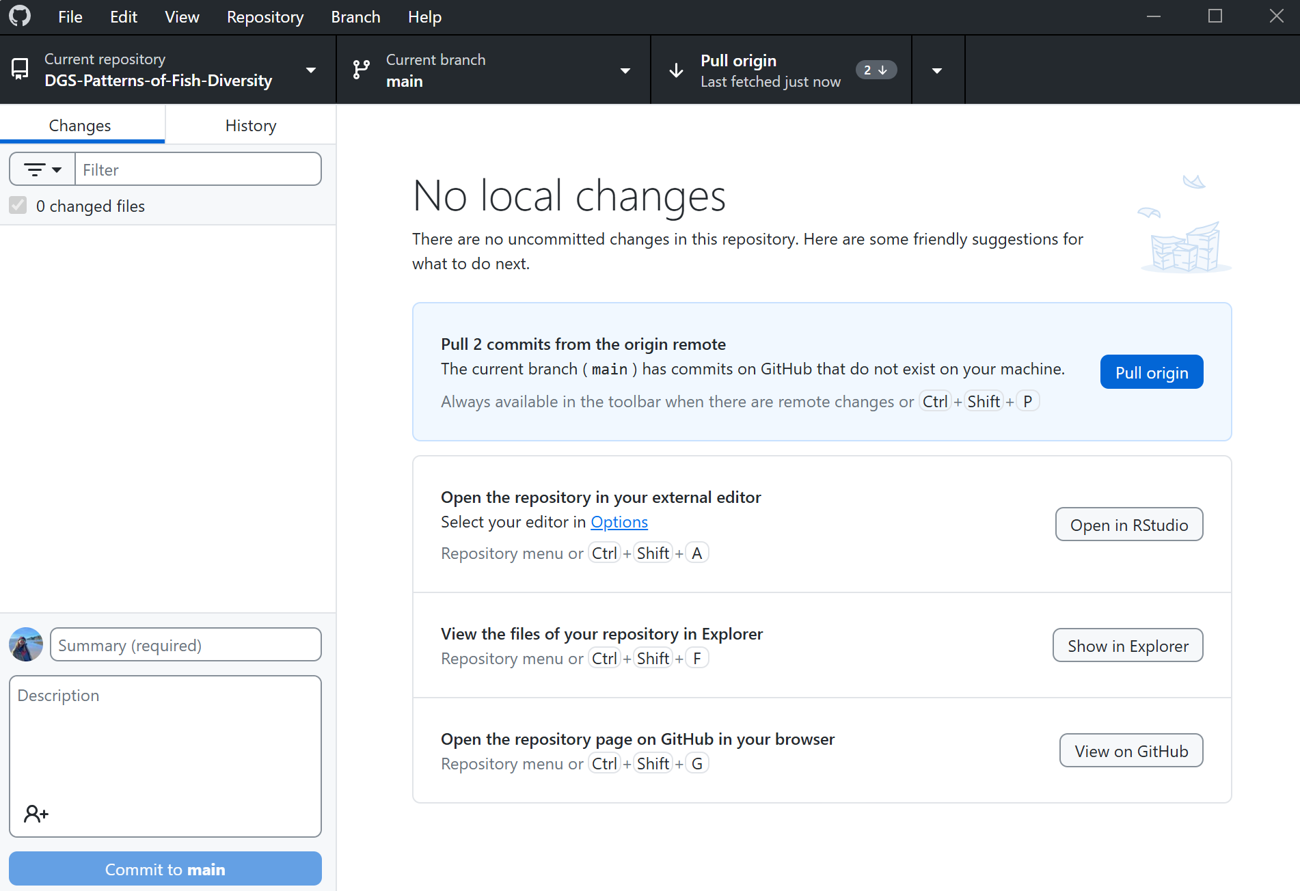
Anatomy of GitHub Desktop
Change branch (only necessary if using branches)
Click to pull repo edits (refresh) from GitHub; indicates time since last refresh
Current repo (the folder on computer)
After editing a file, the changes you made will appear here
Once you’ve made edits, this is where you “name” the change you made and write a description
This blue button will change to “push” once you’ve commit some changes to your local repo… when you click push, it saves your changes to your remote repo
A “commit” will save changes to your local repo

Slide 7
Rules of working collaboratively in repos
As a contributor, clone this repo onto your personal device, do not fork it
Create logical subfolders/scripts for your work and name them clearly
Before beginning work, always "fetch/pull origin" through GitHub Desktop to reduce merge conflicts
At a minimum, you should be pushing your changes to our repo once a day
If we need to use branches (we may not): 1) The main branch should always be deployable - create branches for specific tasks, 2) only one person should be merging completed branches into the main branch, and 3) once branches are merged, delete branches to keep the repo tidy

Slide 8
Getting started with GitHub
Skills exercises:
Introduction to GitHub: https://github.com/skills/introduction-to-github
Review pull requests: https://github.com/skills/review-pull-requests
Resolve merge conflicts: https://github.com/skills/resolve-merge-conflicts

